Slide 1


India All-Star Training: Debug Python Code with VS Code Editor
03.04.2023

Slide 2
Agenda
IDE and Popular IDEs
VS Code for Python
Setting up the environment
Debug Python code in VS Code

Slide 3
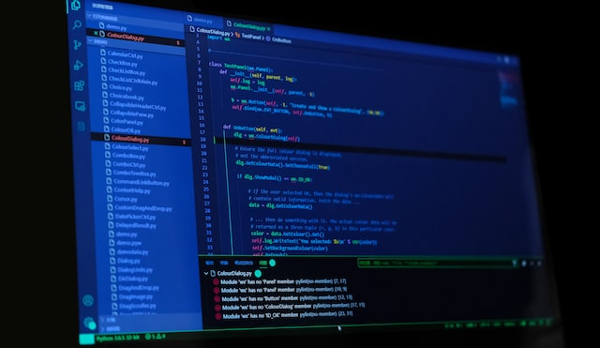
IDE and Popular IDEs
Top Features of IDEs:
Code editor
Debugger
Compiler/interpreter
Version control system
Project management
Code refactoring
Testing tools
Plugins/extensions
An Integrated Development Environment (IDE) is a software application that provides a comprehensive set of tools and features for software development. IDEs are designed to help programmers write, debug, and test code more efficiently and effectively.
Popular IDEs for Python:
Visual Studio Code
PyCharm
Spyder
Jupyter Notebook

Slide 4
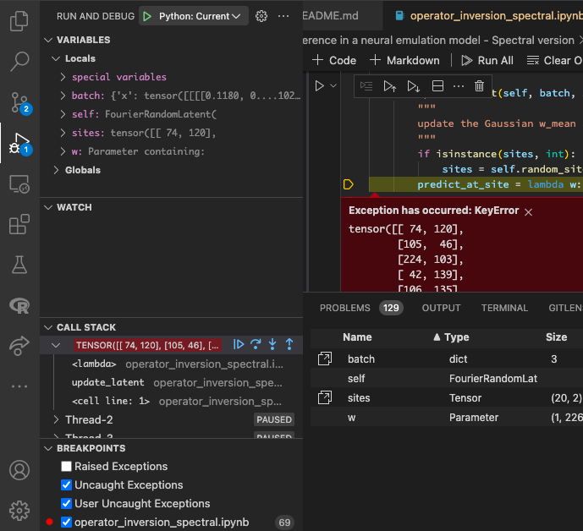
VS Code for Python
Free and open source
Cross-platform compatibility
Customizable user interface
Powerful debugging tools
IntelliSense for auto-completion and error checking
Large extension marketplace
Built-in terminal for command-line interaction
Version control integration with Git
Support for multiple programming languages

Slide 5

Setting up the VS Code environment
Install Python and Visual Studio Code
Install the Python extension for VS Code
Create a new folder for your Python project
Open the folder in VS Code
Install the virtualenv package by running pip install virtualenv
Create a new virtual environment by running python -m venv env
Activate the virtual environment by running source env/bin/activate
Install packages and dependencies specific to your project using pip

Slide 6
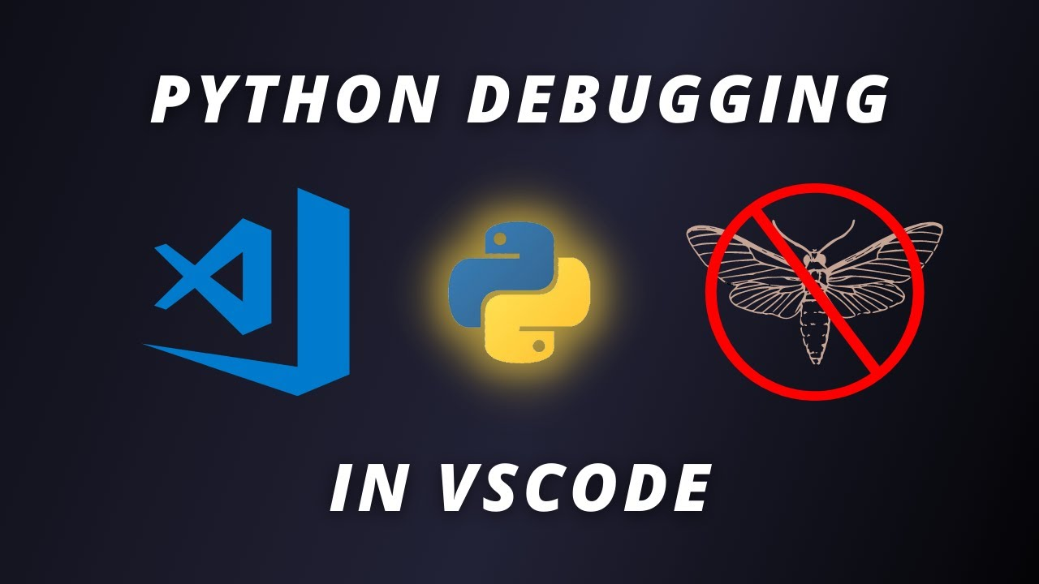

Debug Python code in VS Code
Set a breakpoint in your Python code by clicking on the left-hand side of the editor or pressing F9.
Start debugging by clicking on the "Run" icon or pressing F5.
Choose your debug configuration and configure your environment in the generated launch.json file.
Start the debugger by clicking on "Start Debugging" or pressing F5 again.
Step through your code using the debug toolbar to examine variables and set watches.
Stop debugging by clicking on the "Stop" button or pressing Shift + F5.
Debug Toolbar
Continue (F5) – this will run past the breakpoint and continue with the rest of the program until it hits the next breakpoint.
Step over (F10) – this will take the debugger down to the following line.
Step into (F11) – this will take the debugger into the following function.
Step out (F12) – this will take the debugger out of the function and into the next step.
Restart (Ctrl+shift+F5) – restart the entire debugger.
Stop (shift+F5) – stop the debugging process and exit it.

Slide 7
Assignment
Write test cases for Shopping Cart Module
Creating a Simple Flask Web Application with VSCode
Your task for this assignment is to write test cases for a provided shopping cart program and run them using either the unittest or pytest library in the Visual Studio Code (VSCode) editor. You should install the necessary VSCode extensions to run the tests.
For this assignment, your task is to utilize Flask to develop a basic web application, establish a virtual environment for your project, install the necessary libraries, and debug your code within the Visual Studio Code environment.
you will need to submit three items: a Python script named test_shoppingcart.py containing your test cases for the shopping cart program, a screenshot of the VSCode terminal showing the output of the test execution to demonstrate that the tests have passed, and the code is functioning properly, and list of VSCode extensions installed.
The deliverables for this assignment include a virtual environment for your project, a list of libraries in requirements.txt, a app.py file for your Flask application, a launch.json file for debugging in VSCode, and screenshots of your web application and code in debug mode.

Slide 8
References
https://code.visualstudio.com/docs
https://code.visualstudio.com/docs/python/debugging
https://learn.microsoft.com/en-us/training/modules/python-install-vscode/
https://www.analyticsinsight.net/top-10-vs-code-extensions-for-python-developers-to-learn-in-2023/
https://www.datasource.ai/en/data-science-articles/top-10-python-extensions-for-visual-studio-code
https://medium.com/co-learning-lounge/create-virtual-environment-python-windows-2021-d947c3a3ca78
https://docs.python.org/3/library/unittest.html
https://docs.pytest.org/en/latest/

Slide 9
Thank You

